Slide 1
Finding The Right Bud
Presentation to CEO & CFO of Budweiser
Pinnacle Economics, LLC Todd Garner: Presenter SMU DS 6306 – Project 1
Lani Lewis - contributor
Notes:
Good morning and thank you for the opportunity to provide Budweiser with a quality product from Pinnacle Economics. I’m Todd Garner, CEO of Pinnacle and my partner Lani Lewis and I put together today’s work. We know your time is valuable so, let’s jump right in.

Slide 2
Agenda
Go through questions posed by Budweiser
Summarize insights from the data
Recommendations
Notes:
Since we have limited time, we’ll…….

Slide 3
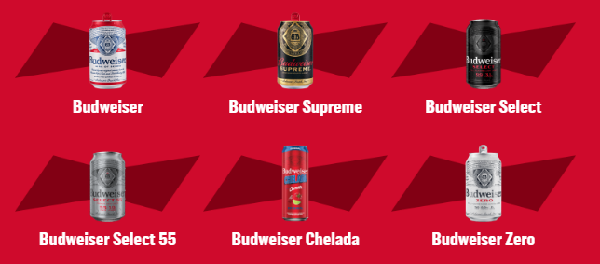
Budweiser Beer
“Budweiser is a medium-bodied, flavorful, crisp American-style lager.”
5% Alcohol by Volume (ABV)
12 International Bitterness Units (IBU)
https://us.budweiser.com/
https://worldfood.guide/list/list_of_beers_in_america_by_alcohol_content_abv/

Slide 4
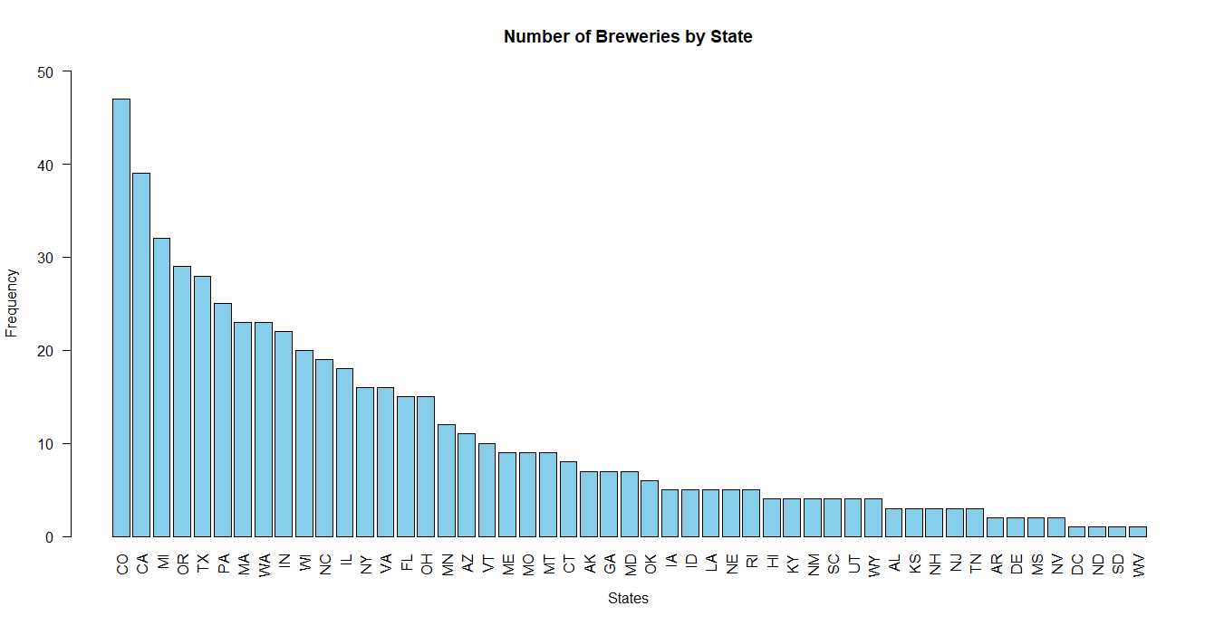
Breweries by State
Notes:
Q1 – Breweries by State

Slide 5
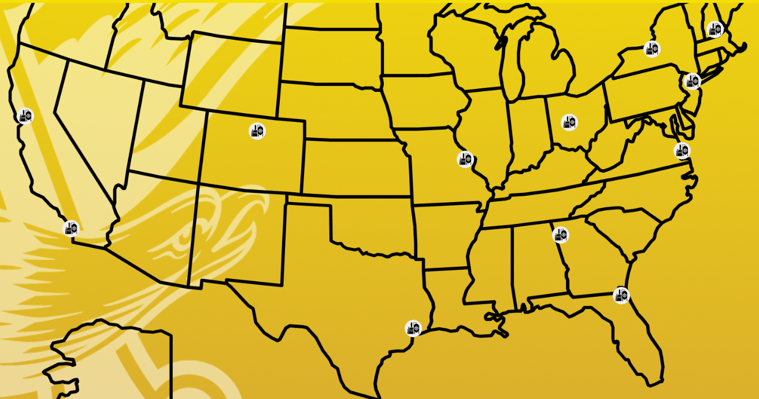
Budweiser USA Breweries
Notes:
Bud breweries, conveniently located near the other concentrations: CO, CA, TX, New England

Slide 6
ADDRESSING THE MISSING DATA
1005 missing IBU values – 2,410 total data observations:
62 missing ABV values – 2,410 total data observations
Conclusion: IBU is important for Brewers, but not particularly relevant to the consumer. ABV is important for all stakeholders
Result: We’ve taken the MEDIAN of both ABV and IBU so as not to skew the data averages.
Notes:
Q3 – Address missing data

Slide 7
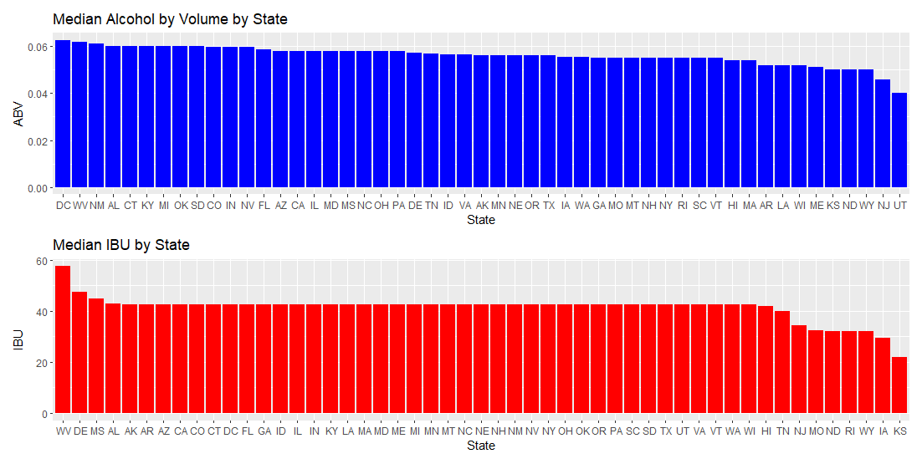
MEDIAN VALUES FOR ABV & IBU BY STATE
Notes:
Q4 – Compute the median ABV & IBU by state

Slide 8
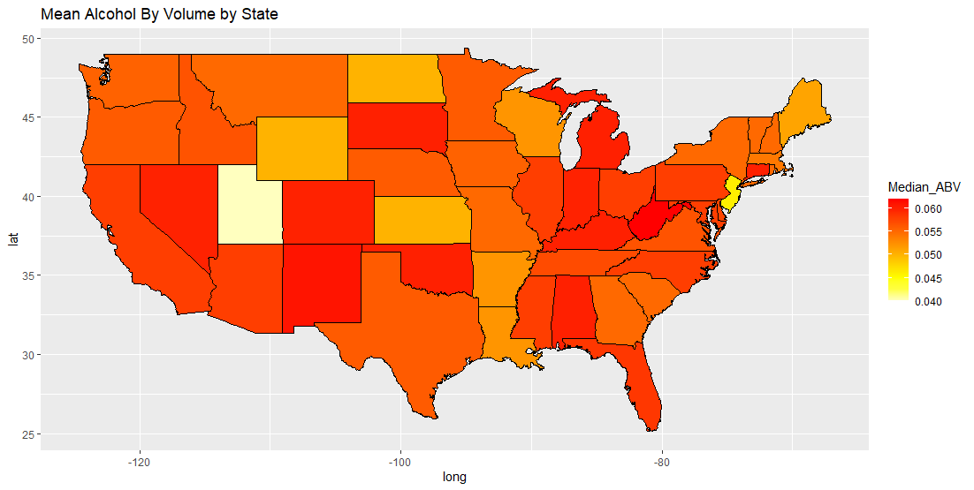
Mean Alcohol by Volume by State
Notes:
Probably more helpful to visualize this metric – Concentrations in the West/Southwest, Upper Midwest and Atlantic states and deep south.

Slide 9
MAX ABV & MAX IBU
MAX ABV: 52 Lee Hill Series Vol. 5 - 12.8% ABV Boulder, CO
MOST BITTER: 375 Bitter Bitch Imperial IPA 138 IBU Astoria, OR
Notes:
Q5 – max ABV and IBU – entire data set

Slide 10
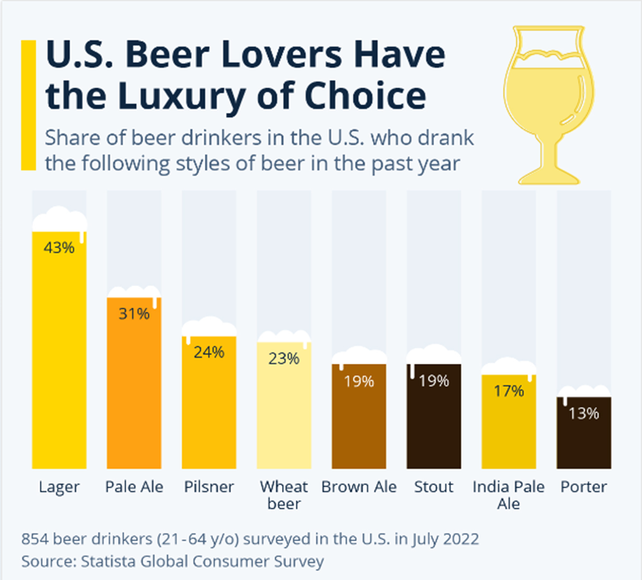
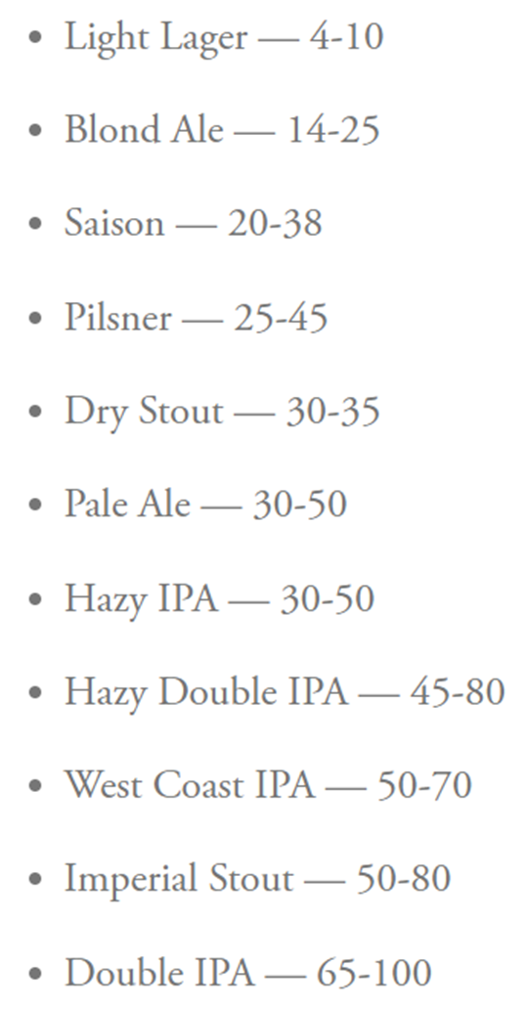
US Beer Type of Choice
IBU By Beer Type
https://www.statista.com/chart/28572/popularity-of-beer-styles-in-the-us/
https://www.firestonebeer.com/what-really-is-ibu/
Notes:
IBU by Style and Types of beers by market share – What this doesn’t show is that the right side of the market share chart has been growing. We’ll come back to this point.

Slide 11
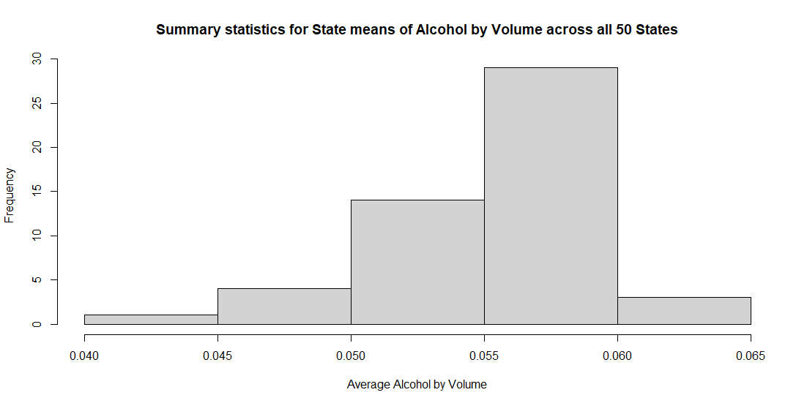
Summary Statistics and Distribution by ABV
Comments on summary statistics and distribution Alcohol by volume for beers – not grouped
MIN: 0.10%
MAX: 12.8%
MEAN: 5.977%
MEDIAN: 5.7%
Notes:
Q6 – comment on summary statistics for ABV – Fairly tight range for Ales & IPAs but edging toward the high end of Budweiser’s Showcase brands.

Slide 12
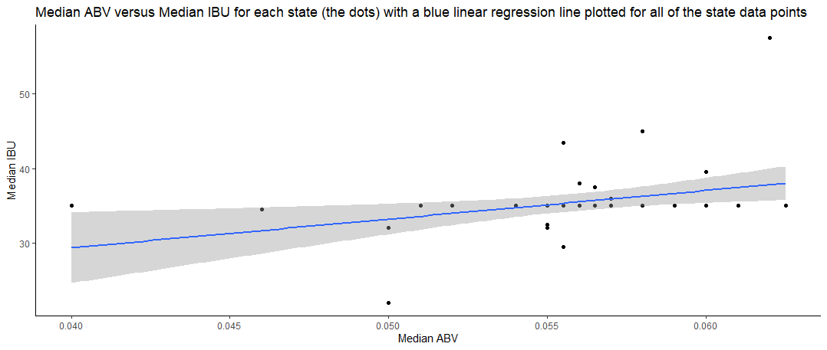
Relationship between ABV & IBU
Notes:
Q7 – is there a relationship between ABV/IBU? Utah low, WV high – positive linear correlation

Slide 13
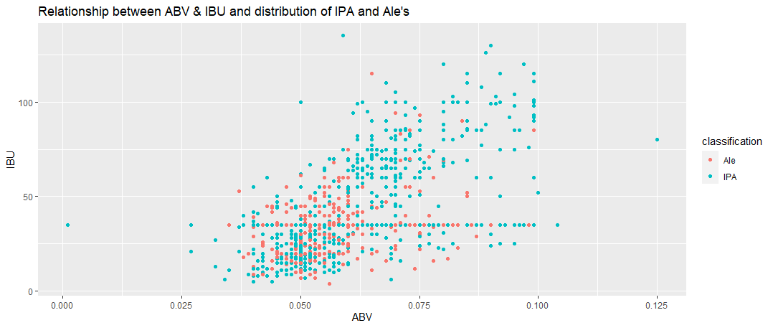
Difference between ABV/IBU – IPA & ALE
Notes:
Q8 – Difference between ABV/IBU for Ales and IPA’s.

Slide 14
Let’s go one step further
INSIGHTS AND RECOMMENDATIONS

Slide 15
Bud today
Billions spent on successful advertising from the early 1800s.
Budweiser Clydesdales
Spuds Mackensie
WASSSUUPPPPP!?!?!?!
Joe “Six Pack” is your hero!
Does Bud want to dilute the Bud brand with a “Bud IPA” or “Bud Pale Ale”
This could potentially irritate Joe “Six-Pack”

Slide 16
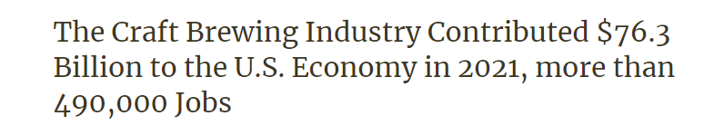
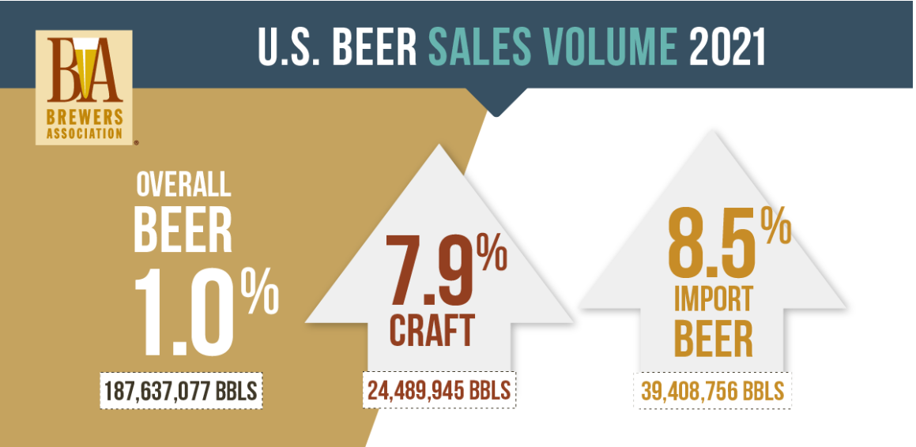
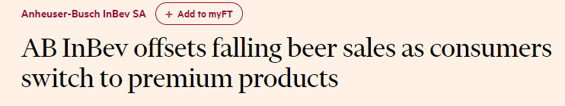
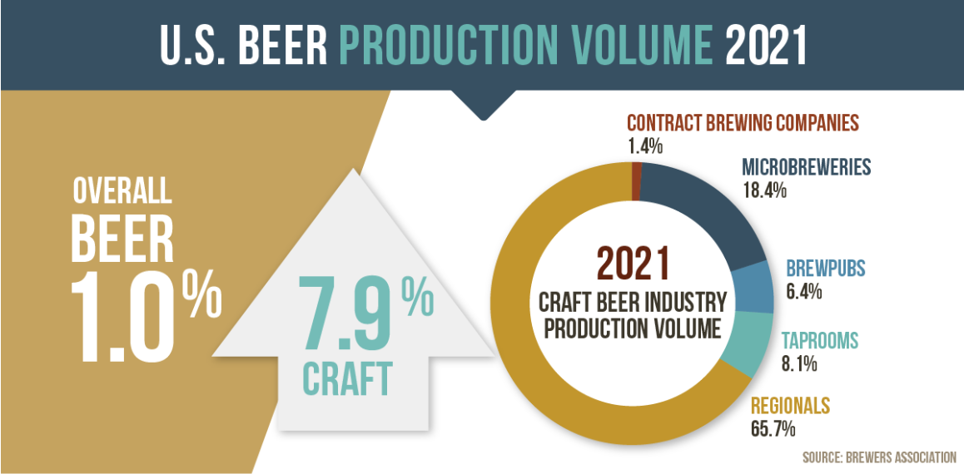
Market Research Shows:
Beer Advocate: “Putting the beer into geeks since 1996”
Notes:
Impossible to ignore that America’s tastes are evolving. What used to be the random “one off” beer on the menu is now crowded with the other craft brews. Found in Premium establishments are required now to satisfy the tastes of the discerning beer drinker.

Slide 17
Further Market Research
Beer drinkers want more alcohol per beer
“I can drink two and get the same effect as 4 regular beers and have some left over for later.”
Craft beers garner a premium price
Also have higher ABV/IBU
Premium Beer for a Premium Price!

Slide 18
Beer Advocate Top 250
Source: https://www.kaggle.com/datasets/bengosha/beer-advocate-top-250-beers

Slide 19
Economic Impact – Craft Beers
Source: https://www.brewersassociation.org/statistics-and-data/economic-impact-data/

Slide 20
Economic Impact – Craft Beers
Source: https://www.brewersassociation.org/statistics-and-data/economic-impact-data/

Slide 21
Recommendations
Invest further into partnerships with Craft Breweries
They have plowed the hardest ground
Use Bud’s:
Economies of Scale
Distribution
Capital Investment
Operational Efficiencies
Join them as partners and reap the rewards.
Invest quietly – Joe “six-pack” and Beer “Nerds” can peacefully coexist…whether they know it or not!

Slide 22
Thank You For Your Business!
Todd Garner
Pinnacle Economics, LLC
DS 6306 Case Study 1 – EDA
Lani Lewis - contributor

